Slide 1
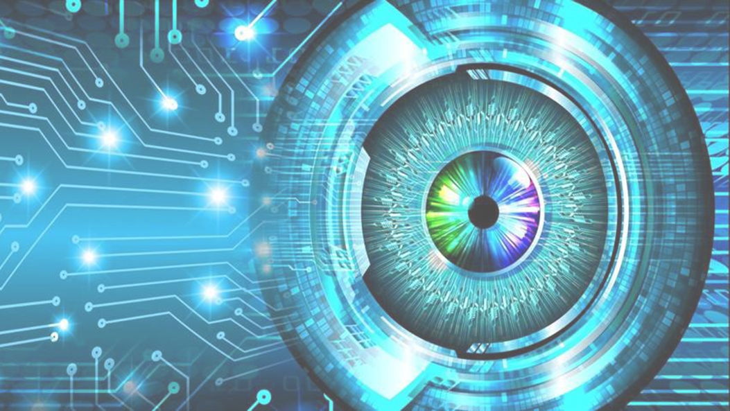
Introduction to Image Processing

Slide 2
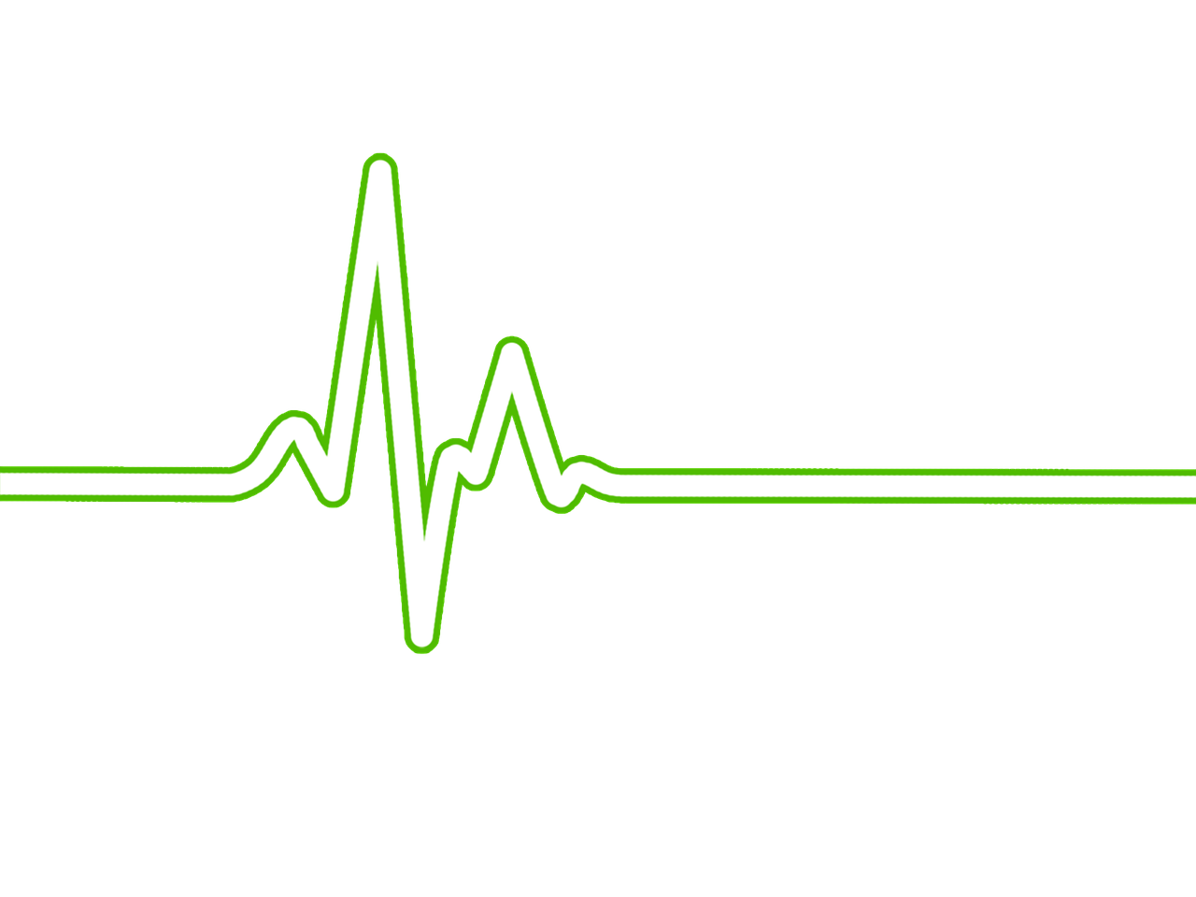
Review from Last Module
What is a signal?
What is noise?
What is a filter?

Slide 3
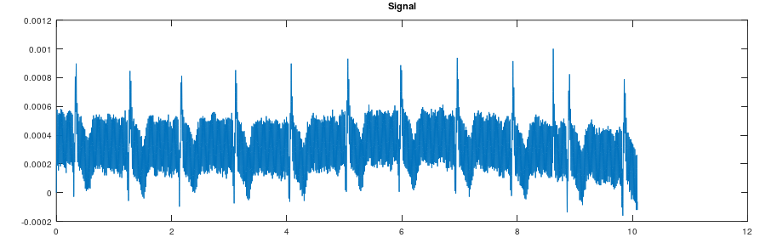
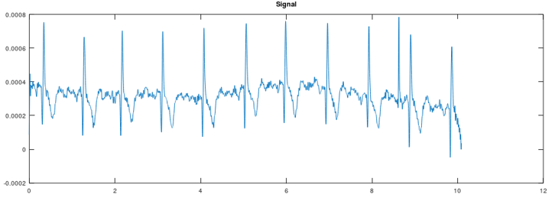
Noise Interference in Biosignals
Apply Lowpass filter to denoise signal

Slide 4
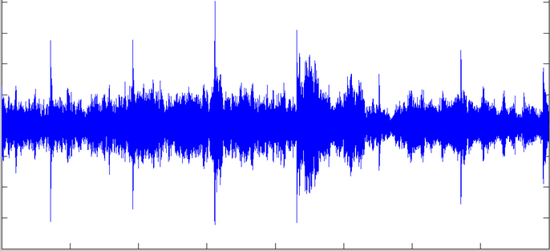
Is this a Signal?
Yes!

Slide 5
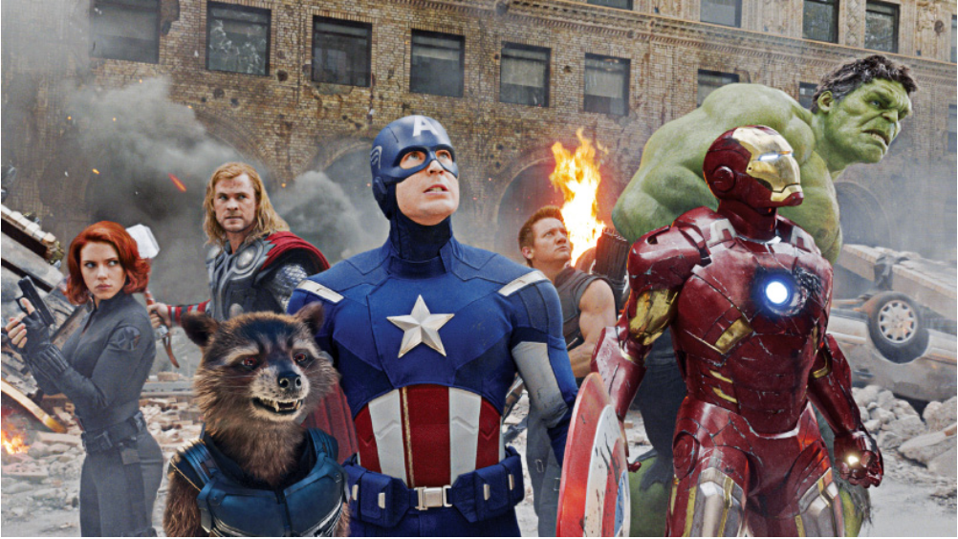
Is this a Signal?
Yes; in fact, images are also signals

Slide 6
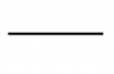
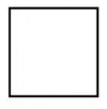
Images Signals, just in 2 Dimensions
1 dimension
2 dimensions

Slide 7
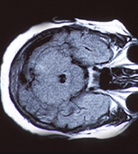
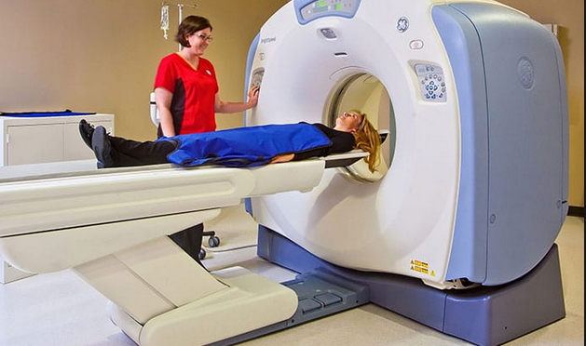
Types of Biomedical Images
Computed Tomography (CT)

Slide 8
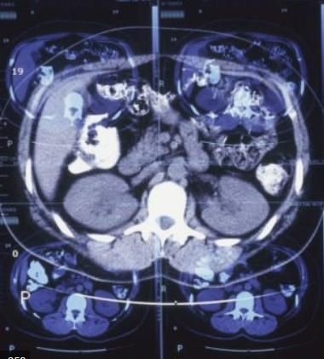
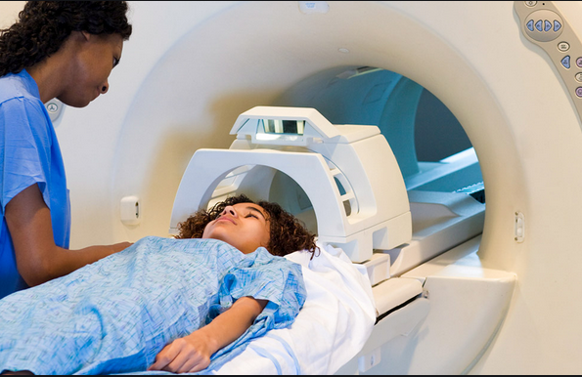
Types of Biomedical Images
Magnetic Resonance (MRI)

Slide 9
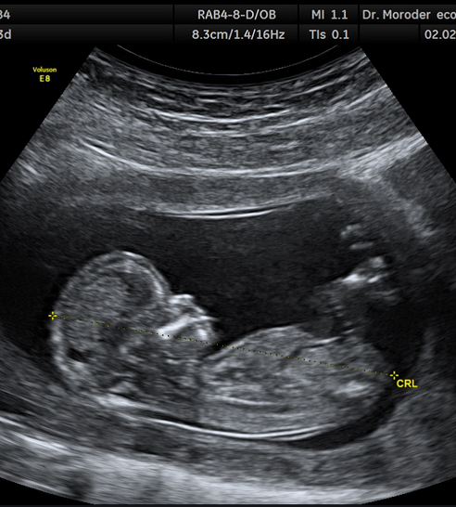
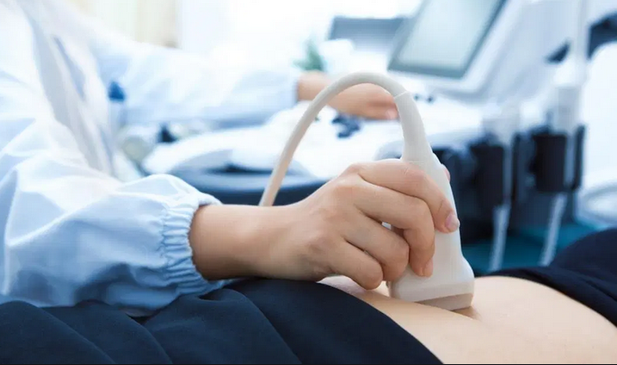
Types of Biomedical Images
Ultrasound

Slide 10
Since Images are Signals…
Everything that you’ve learned about biosignals applies to them:
Frequencies
Noise
Filtering

Slide 11

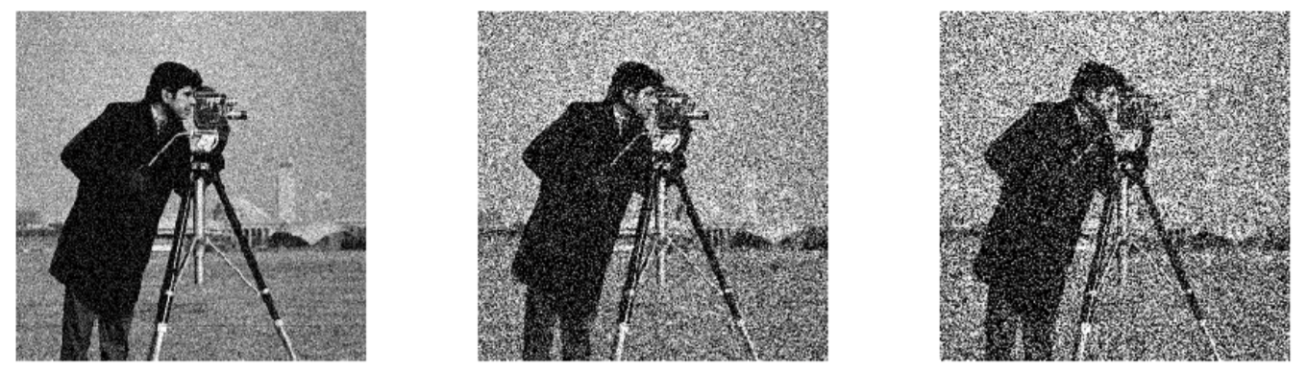
Image Noise: Gaussian
Gaussian Noise = 0.01
Gaussian Noise = 0.05
Gaussian Noise = 0.10
Original Image

Slide 12
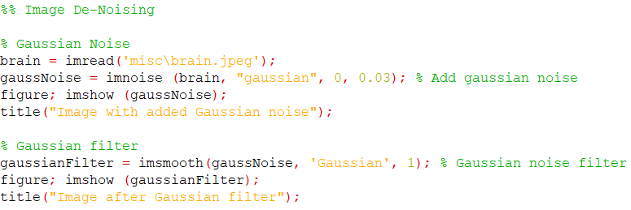
Image Noise Filtering: Gaussian

Slide 13
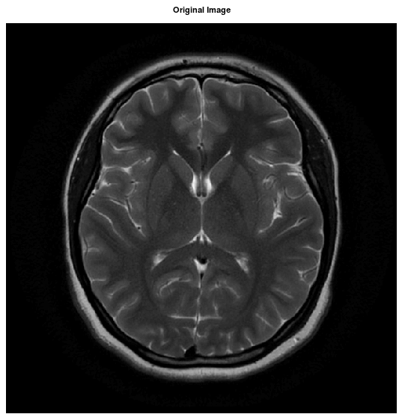
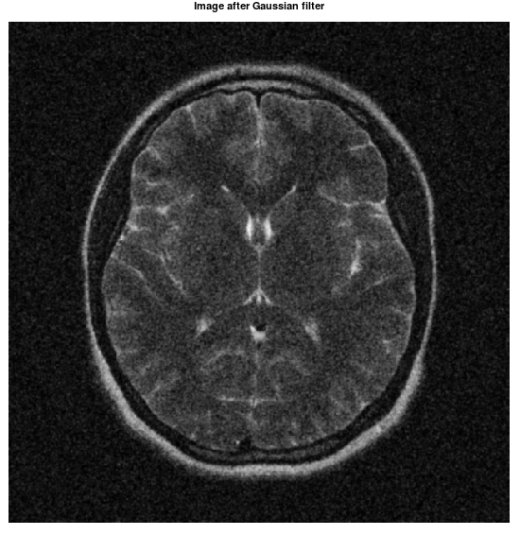
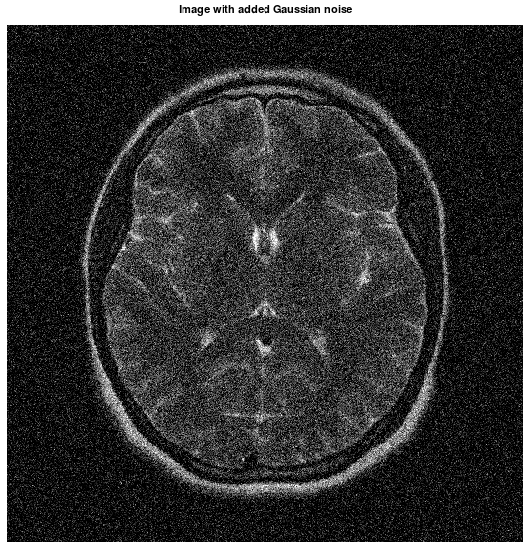
Gaussian Filter!

Slide 14
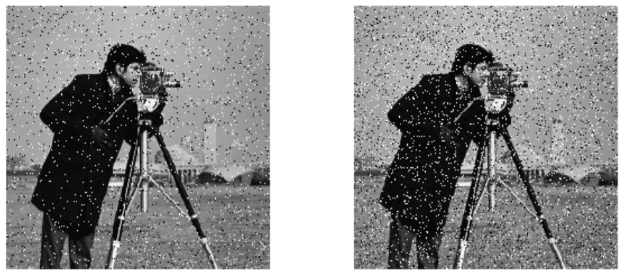
Image Noise: Salt & Pepper
Salt & Pepper = 5%
Salt & Pepper = 10%
Original Image

Slide 15
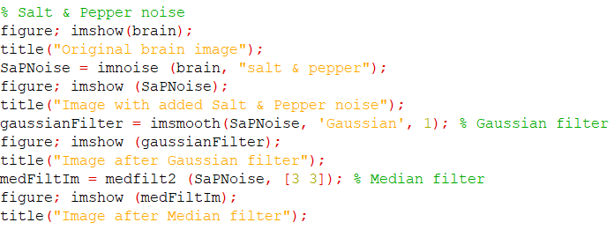
Image Noise Filtering: Median Filter
*How do the Gaussian filter results differ from Median filter?

Slide 16
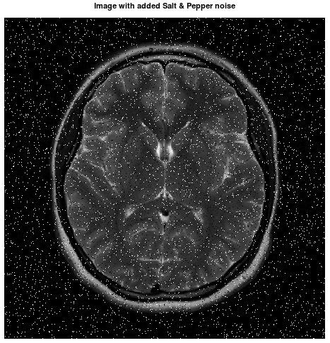
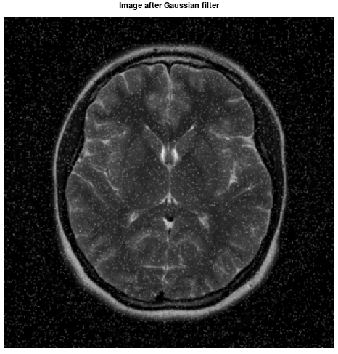
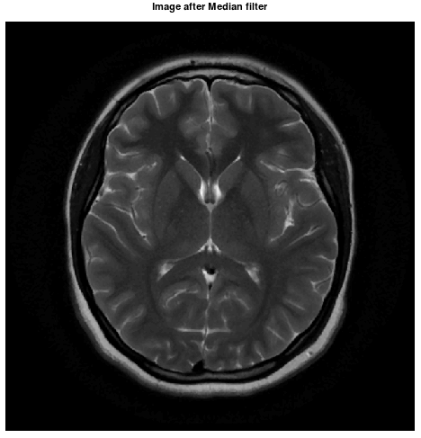

Slide 17
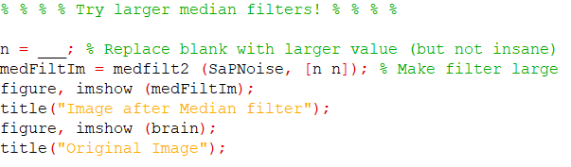
Median Filter: What Size???
15

Slide 18
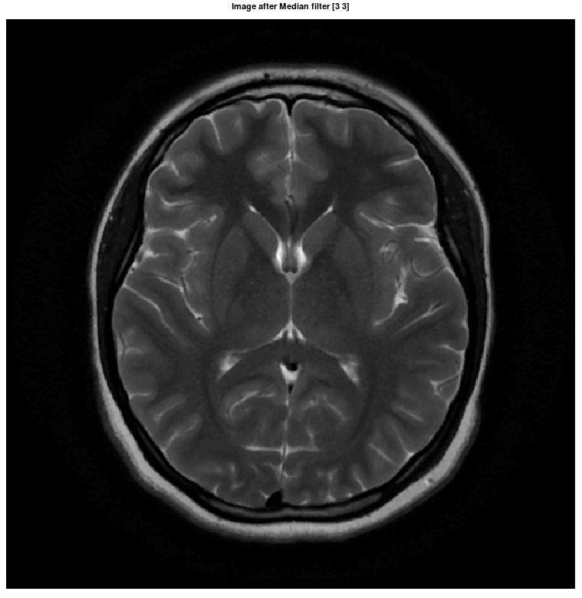
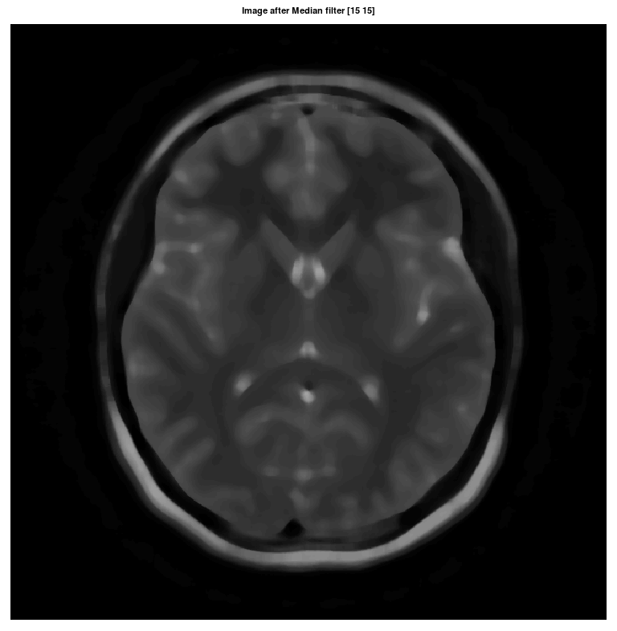
*Is this a good size for Median filter?

Slide 19
DISCUSSION

Slide 20
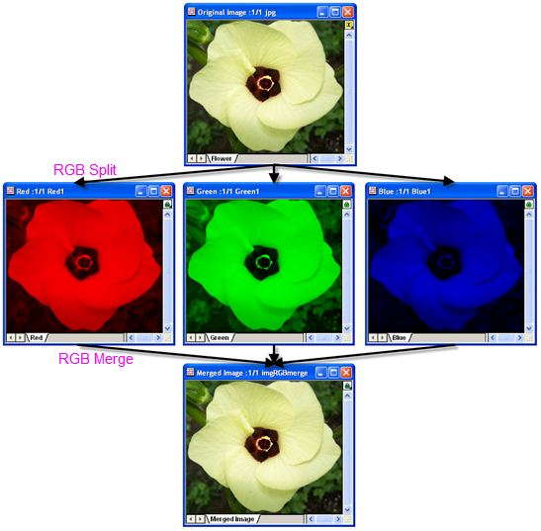
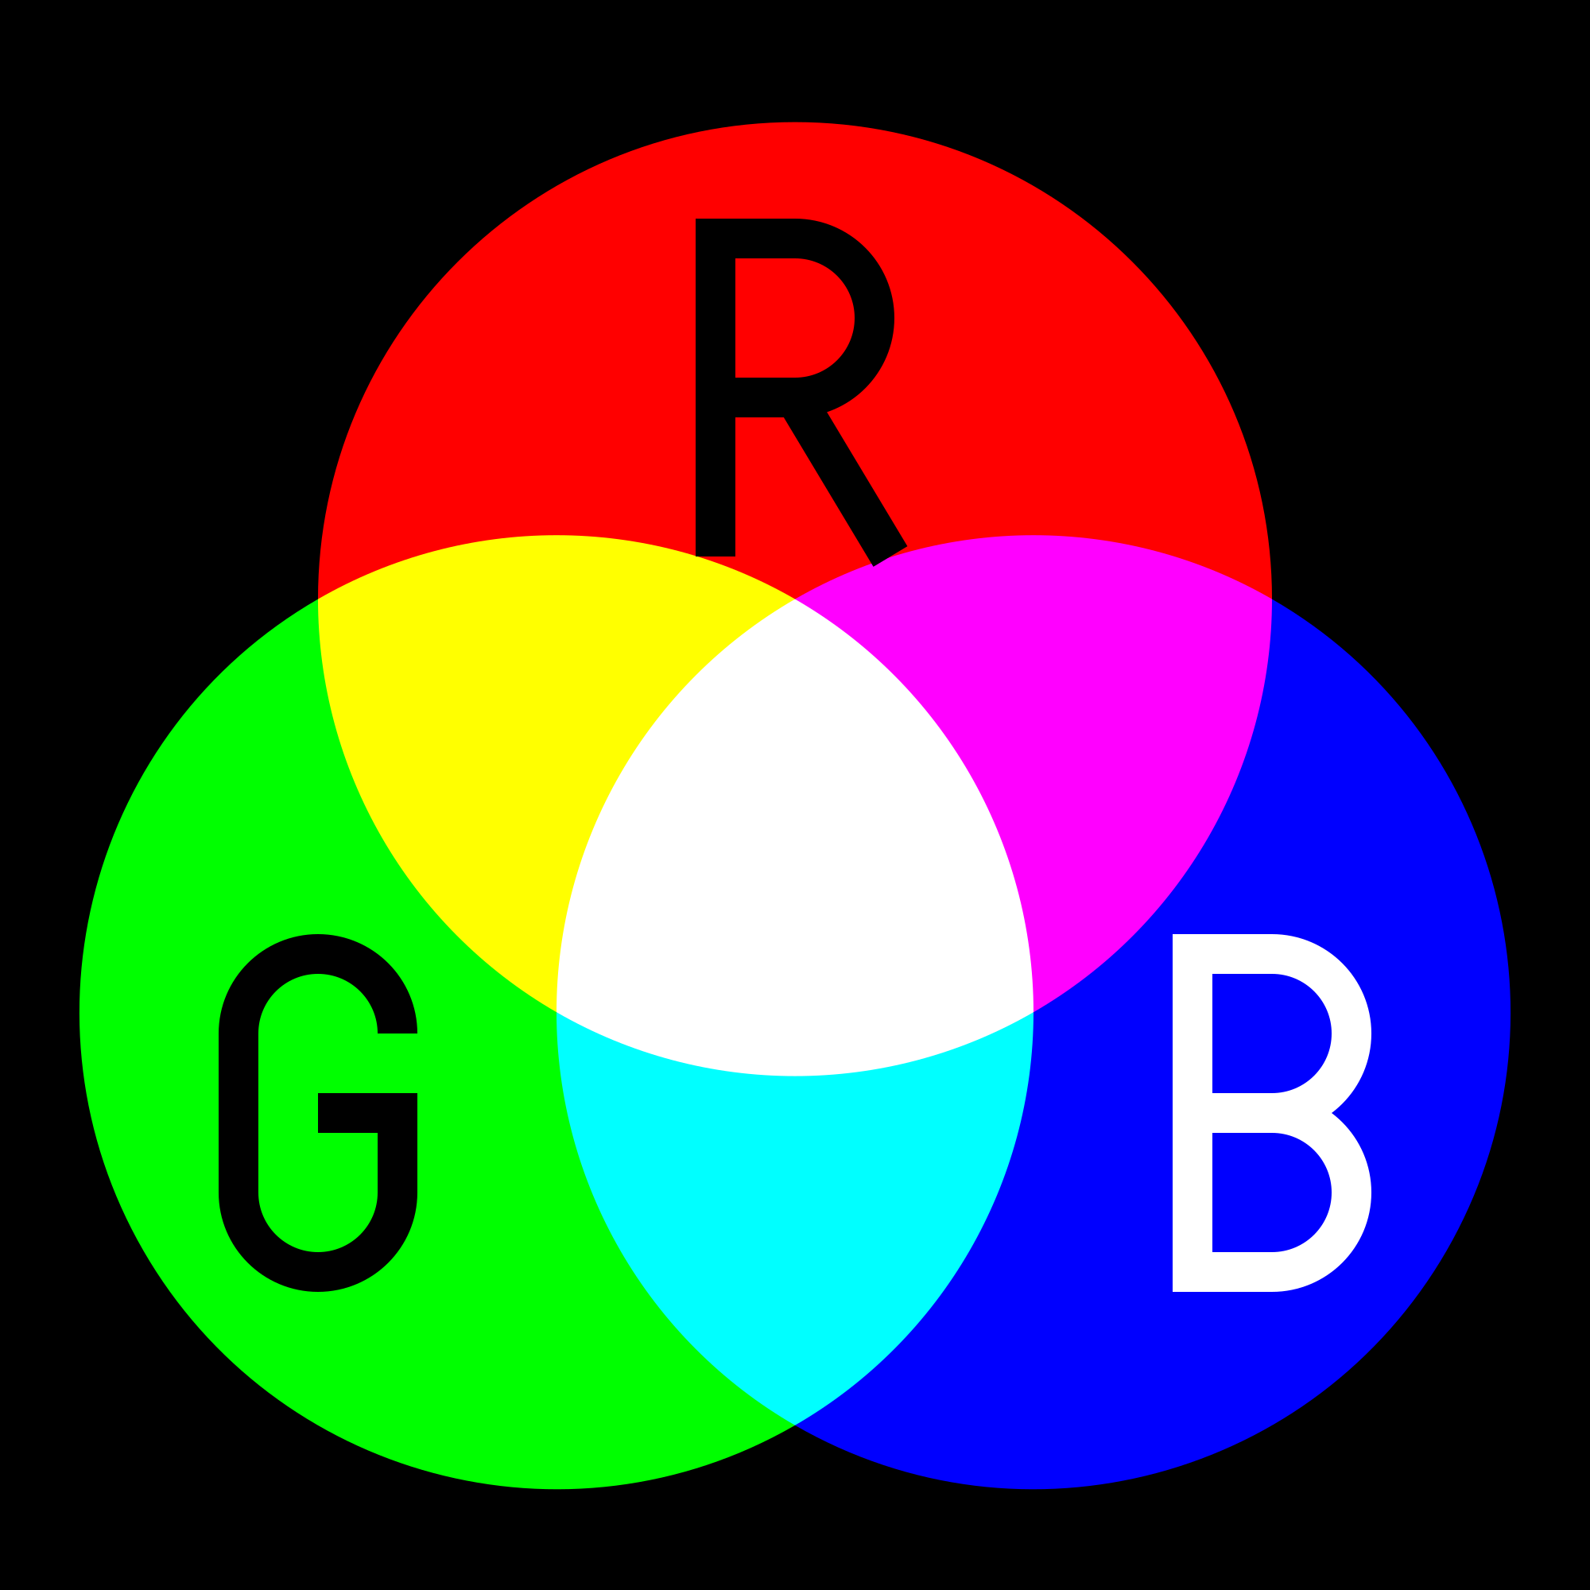
RGB
Two different image types:
Black & white
RGB
Each RGB image is made up of three images (Red, Green and Blue)

Slide 21
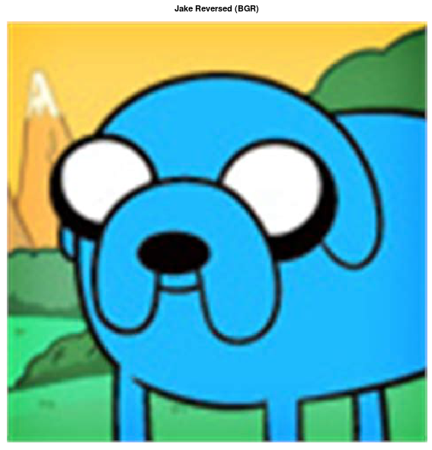
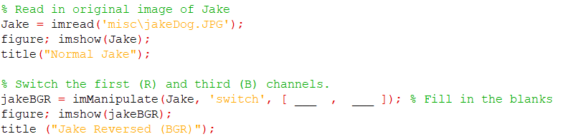
RGB Images: Jake the Dog

Slide 22
Activity #1: Image Fixing

Slide 23
Open “imageRepairRH.mat”

Slide 24
Objective
Each group will repair one RGB image.
The image “noisyIm.tif” should be loaded and will look something like this.
Each group will have to use the imManipulate() function at least three times to *fix the image*.

Slide 25
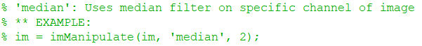
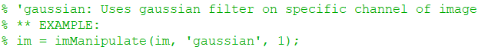
Fixing the Noisy Image
To fix the noisy image, each group should use “imManipulate()” to:
‘switch’ two color channels.
‘median’ filter one channel.
*AND* ‘gaussian’ filter one channel.

Slide 26
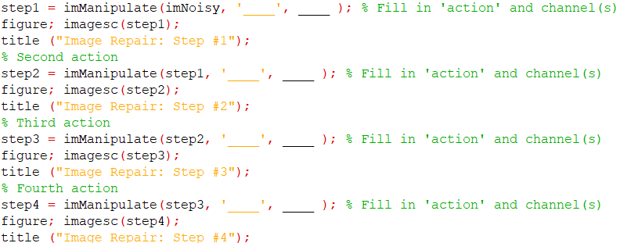
Procedure
Each “step” should be a different image processing action.
Make sure to fill in both an action and channel(s)*.

Slide 27
When you think your group has fixed the image, call an EA over to check!
GET STARTED!!!

Slide 29

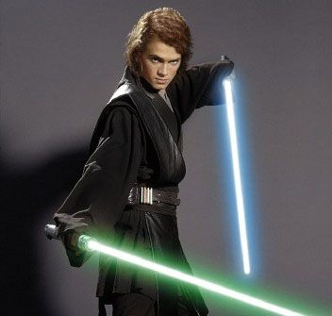
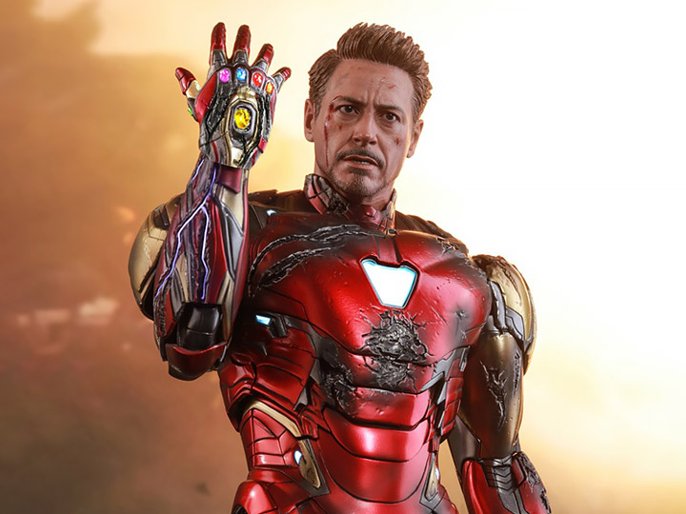
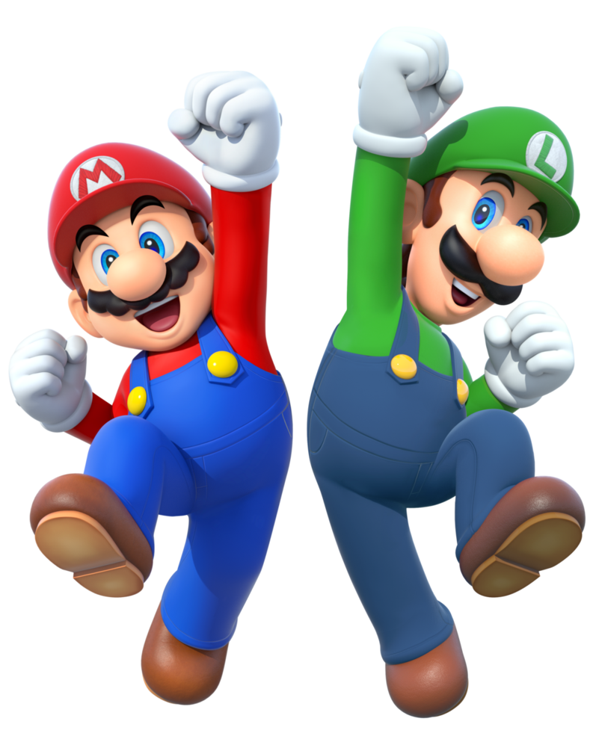
Final Images!

Slide 30
DISCUSSION

Slide 31
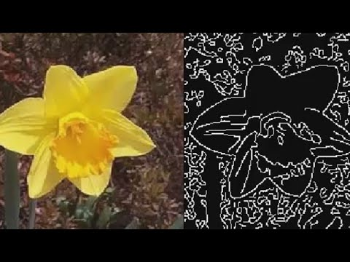
Edge Detection for Images
Edge detection is an image filtering method that highlights sharp changes (i.e. edges) in an image.

Slide 32
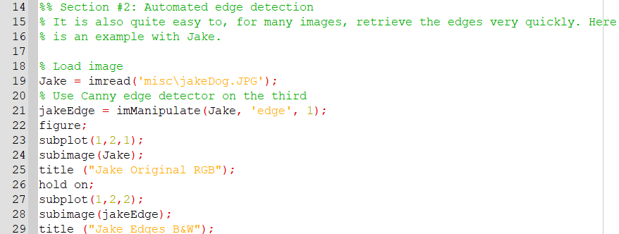
Try Running Edge Detection Filter
Open imgProcessingDay3_Part2.m in Octave
Run the first section

Slide 33
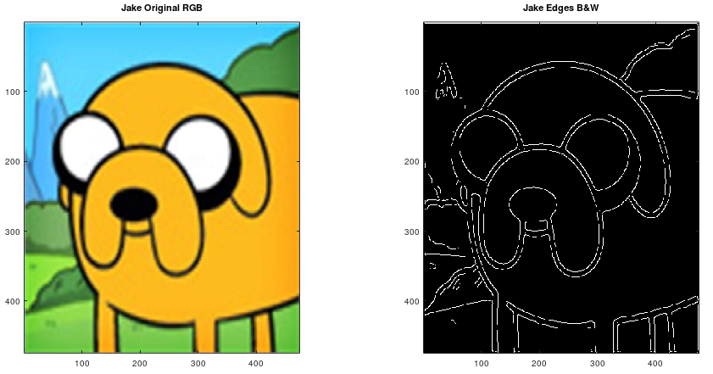
Edge Detection on Jake

Slide 34
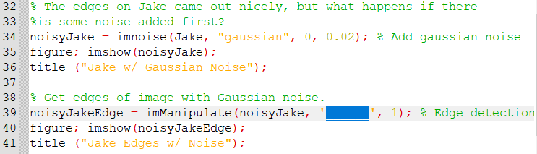
How does noise effect edge detection?

Slide 35
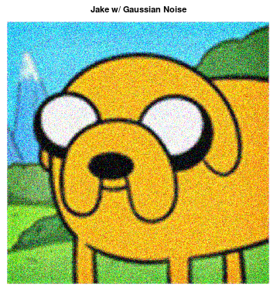
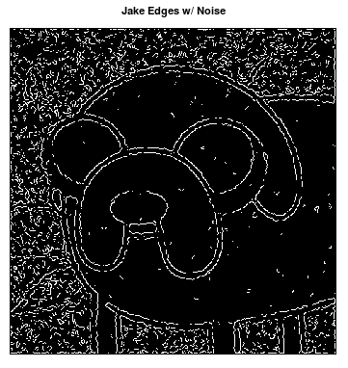
Noise Severely Effects Edge Detection

Slide 36
Solution
Ideas?
Just like with other signals, we can use filters to help remove noise from images.
Gaussian filter is effective for smoothing this random noise

Slide 37
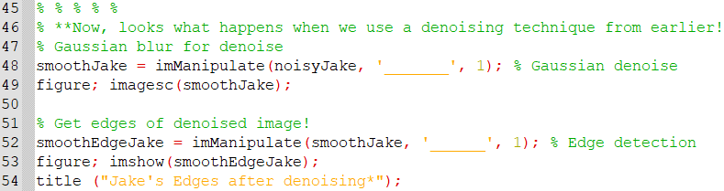
Use Gaussian filter

Slide 38
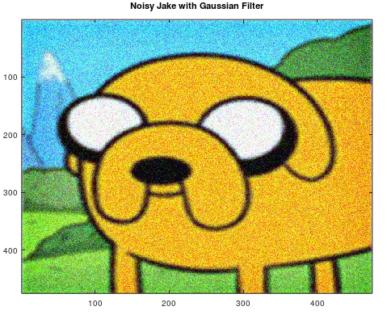
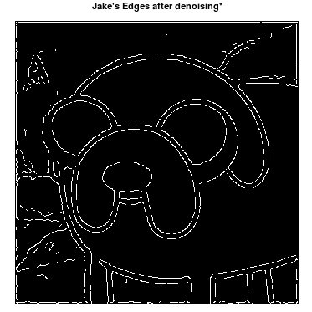
Result: Much Better Edge Detection

Slide 39
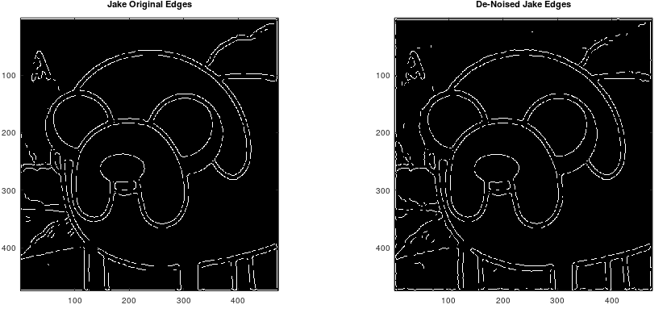
Denoising almost attains original image result

Slide 40
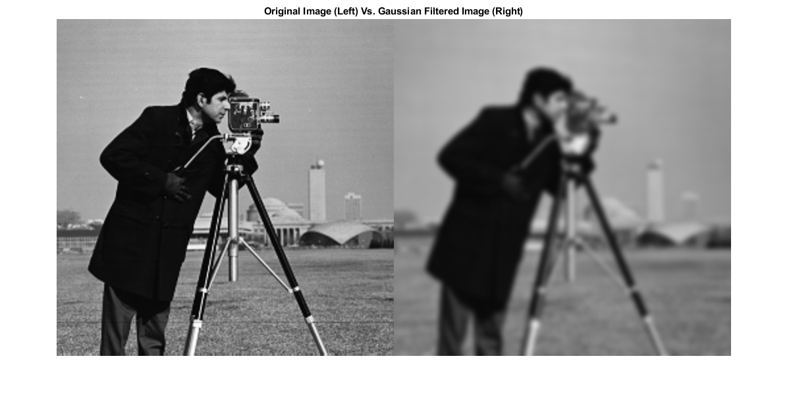
Filtering can come at a cost
Using gaussian filter blurs image

Slide 41
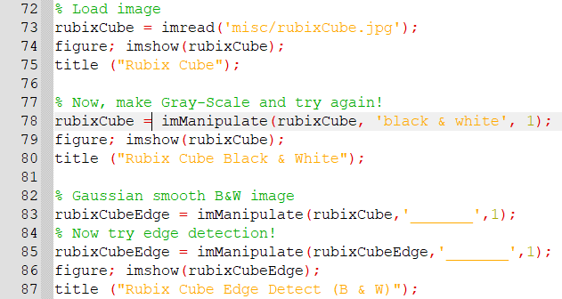
Try the following example

Slide 42
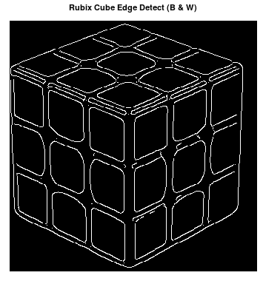


Results

Slide 43


Why is this important?
Edge detection is one of many techniques used to help highlight abnormalities in bioimages.

Slide 44
BREAK

Slide 45


Where’s Waldo??!
Waldo

Slide 46

Finding Waldo isn’t always easy
*Can image processing help?!

Slide 47

Automated Waldo Detection

Slide 48


Brightest spot is Waldo’s location

Slide 49


Slide 50
DISCUSSION

Slide 51

Why is this important?
Radiologists are doctors that use imaging to diagnose injuries and illnesses.
Smart medical image processing and filtering is very important for doctors for diagnosing disease.

Slide 52

Example: Viral Detection
CT scan of lungs for abnormalities.
What is wrong with this patient?
COVID-19

Slide 53

Counting Passes

Slide 54


Slide 55

In a study, 83% of radiologists DID NOT see the gorilla.
Many human factors are involved during expert-level assessment of biomedical images.
How can image processing help?

Slide 56

Automated Brain Tumor Identification
yes
Y1

Slide 57

Why this task is a little hard…

Slide 58
DISCUSSION

Slide 59

Retinal Blood Vessel Segmentation
Segmenting blood vessels is notoriously challenging.
Is needed for diagnosis of many eye-related diseases.
Manual segmentation is time-consuming, subjective and repetitive.
How can image processing help?
Automated vessel retrieval

Slide 60

Your Objective
There exists a “best” channel from RBG retinal images to extract blood vessels.
Figure out which channel (red, green or blue) gives best blood vessel segmentation.
Validate this using at least three images.

Slide 61

OCTAVE Script
R: 1
G: 2
B: 3
Make sure to validate with at least three images and call over an EA with your images displayed and answer when ready!

Slide 62
Takeaway thoughts for bioimage processing
https://www.youtube.com/watch?v=Gigd1rkZTSE

